Slide 1
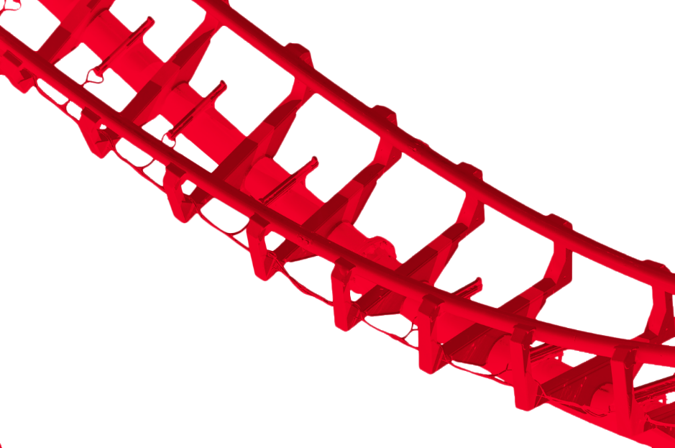
Coaster Crunch
A project by Team Blue

Slide 2
What is Coaster Crunch?
Coaster Crunch is a single page web application that aims to inform readers about the different types of roller coasters that can be found throughout the world.
Team Blue built a database from scratch, utilizing resources around the web.

Slide 3
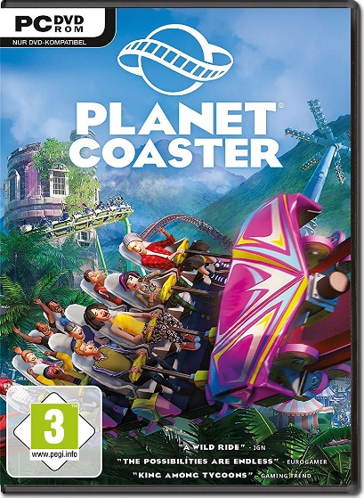

Who is it for?
The objective of Coaster Crunch is to provide coaster
enthusiasts with a simple set of data that provides more
information about their favorite thrill rides.
Readers might use this as an inspiration to place new
coasters on their "must-ride" list, or build them in
coaster emulation games such as
Planet Coaster and Rollercoaster Tycoon.

Slide 4
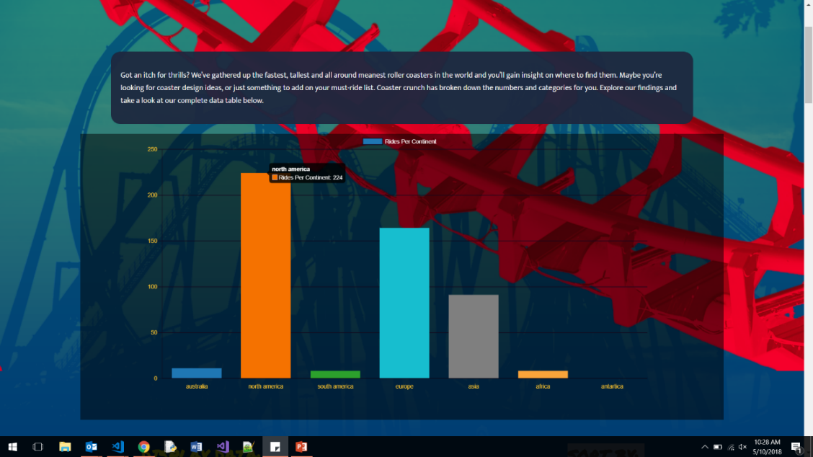
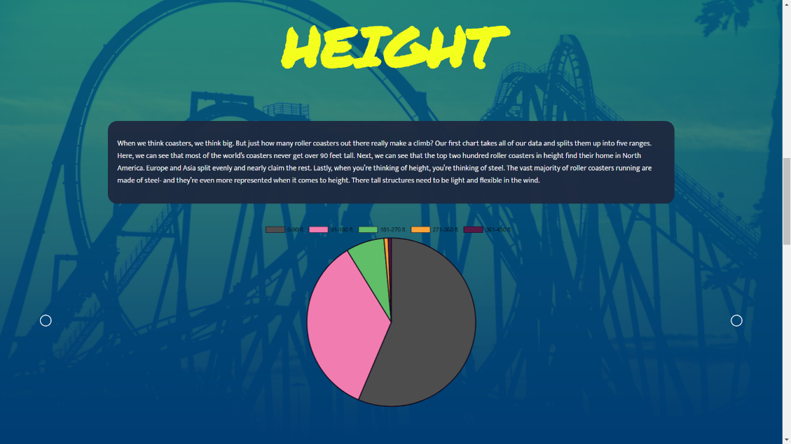
DESIGN
The Page is broken into 3 major components: The main bar graph, a collapsible data table and three pie charts.
Here we have a sample of the main bar graph and one of the pie charts. We will go into greater detail on their inner workings soon.

Slide 5

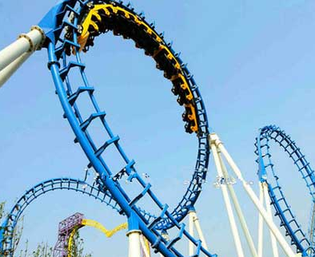

DESIGN
For color design, we wanted the page to be bright and even a little loud. We drew inspiration from the basic color combination associated with carnivals and circuses; red and yellow. Blue is a complementary color in this design scheme. Each color can commonly be found on roller coasters as well.

Slide 6
The Database
The database that we used consists of 508 JSON objects. These objects have 7 key value pairs that we used to generate the results that you see on this project.
These value pairs are name, length, height, speed, type, park, and continent. With this database, users are visually presented multiple charts that break down different statistics, from coasters per continent, to average speed and more.

Slide 7
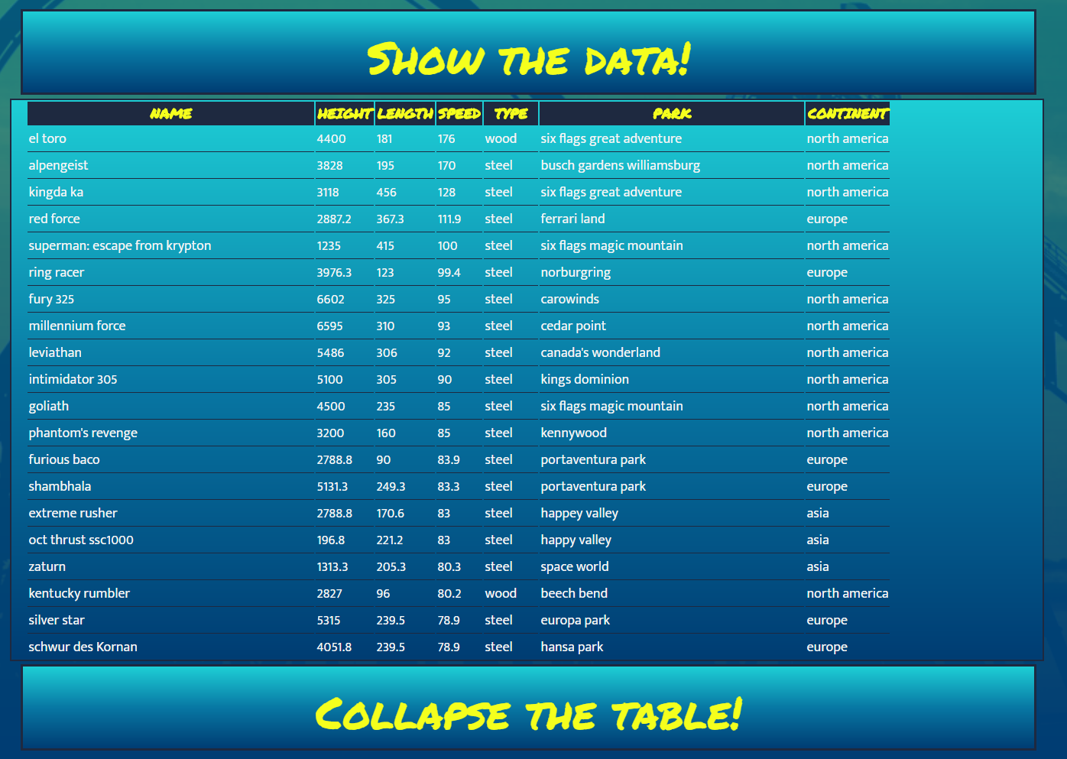
The Database
The data can be accessed by the user with a table on the page. This table can be instantly sorted in ascending or descending order based on height, speed or length.
The table is contained and scrollable, and the user my collapse that table at any time. The table will also show the user what type of material the coaster is built from, as well as the park it operates in and on what continent.

Slide 8

How is it all done?

Slide 9


What is Angular?
Angular is a platform and framework for building client applications in html and typescript. Angular applications are written using typescript (similar to javascript) and is developed by google.
Angular has 3 versions (Angular js, Angular 2, Angular 4, Angular 5 on the way?)
Websites built with Angular include Paypal and Netflix

Slide 10
Angular Overview
An application is a collection of components.
The top level component is the application itself. This sits in the “app” folder. This means the application is a component calling in all other components.
The application component is not the only component that may call another, however. When a component is called and rendered, it will call any of its child components along for the ride.
The basic building blocks of angular are ngModules which provide a compilation context for your components.

Slide 11
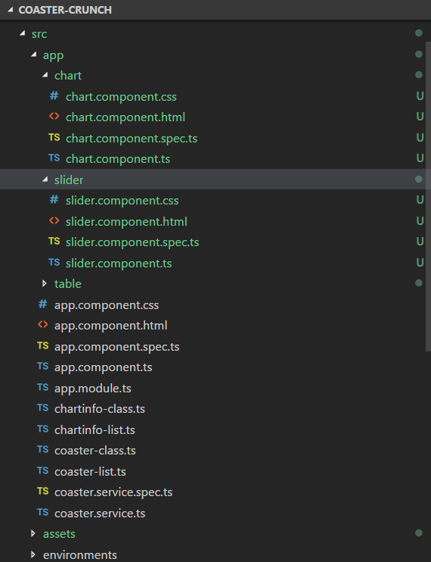
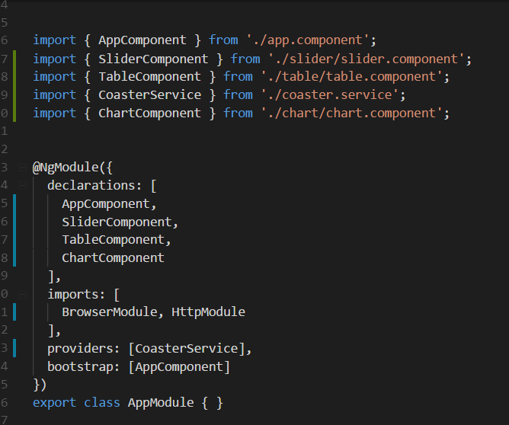
Angular OVERVIEW
An overview of the components layout and the @NgModule

Slide 12
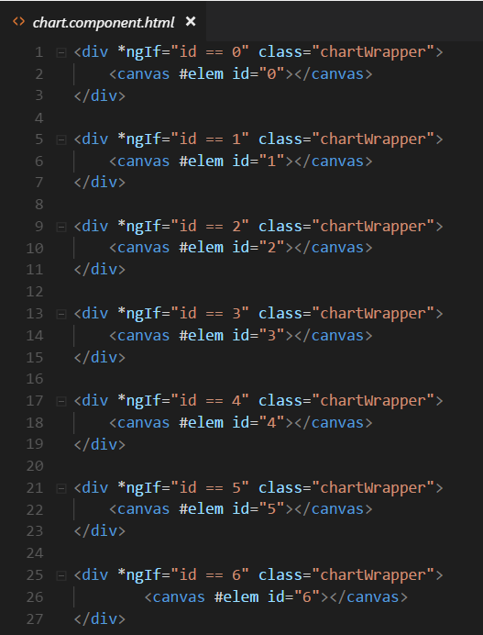
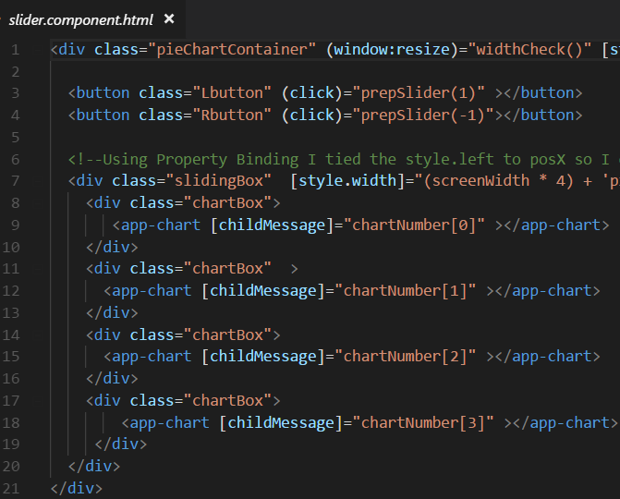
Angular OVERVIEW
A sample of the chart component template, and how that is inserted into the slider component.

Slide 13
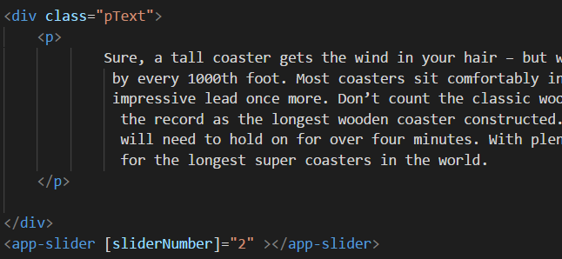
ANgularOverview
Templates are a combination of HTML and Angular markup that modify the HTML displayed in the view.
Angular directives are programing logic that can be put into the HTML markup.
Here is a small example of the insertion of a slider template, which as we have seen on the previous presentation slide, has a chart component template nested within.

Slide 14
Angular Overview
This comes together with property binding. Property binding is a feature that allows you to pass data from the component class to an element in the component’s template.
Event Binding is making your app listen for certain user actions and then updating the app accordingly.
Binding uses {{curly_backets}} to indicate where the data is being passed in.
Information is supplied to the components via services. Services perform operations that are not related to the view.

Slide 15
Using Angular for Coaster Crunch
Implementing a algorithm
Building a table
Creating a slider
Inserting Charts
Utilizing a service

Slide 16
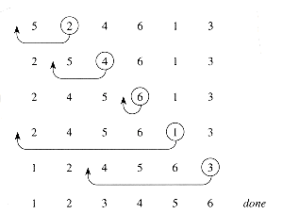

Insertion Sorting Algorithm
The algorithm that Team Blue was assigned is the insertion sort. This algorithm sorts the data presented one item at a time. It is not considered an efficient algorithm when working with large data sets, but is works great when working with smaller amounts of data.
You can imagine this a bit like sorting cards in your hand. Imagine that your left hand is hold a 3 of hearts, and then you pick up a 5 of spades. You will place the 5 after the 3. If you pick up a 4 next, you will move it to the left, after the 3 and before the 5. The algorithm does this by checking each value as it moves down the “hand”.

Slide 17
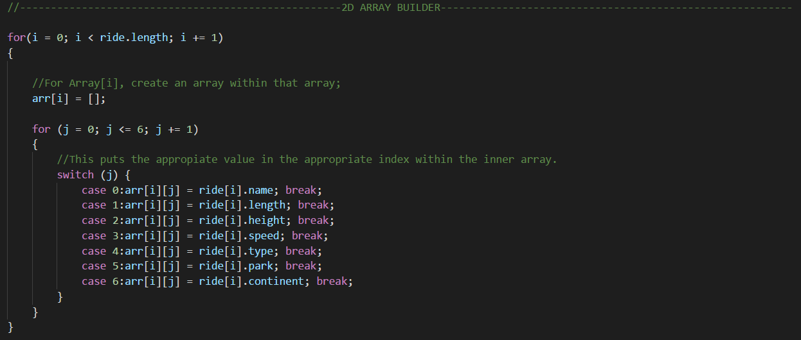
STEP # 1
First, we put all of the info from our JSON file into a 2D array. The code below would create 508 lists containing our 7 value pairs. The reason that we used a 2D array is because when we sort the items and switch the placement of 1 item, we can switch the placements of all the corresponding items by referencing (i) instead of (j). Keeping the correct value pairs within parallel 1 dimensional arrays would have been less efficient and more confusing.

Slide 18
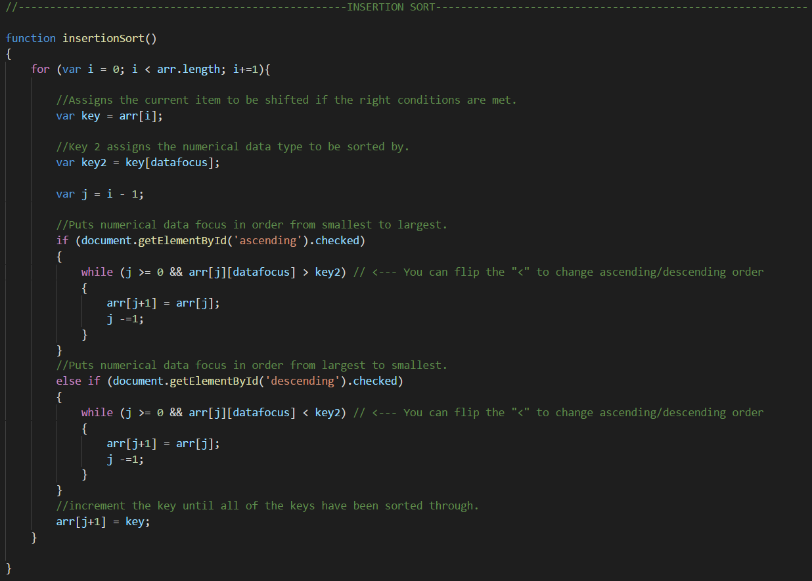
Step # 2
We take the arr[] array and use the insertion sort to manipulate the placements of arr[]’s values. The coaster being evaluated is assigned to key, whereas the value pair being sorted by, is assigned to key2.

Slide 19
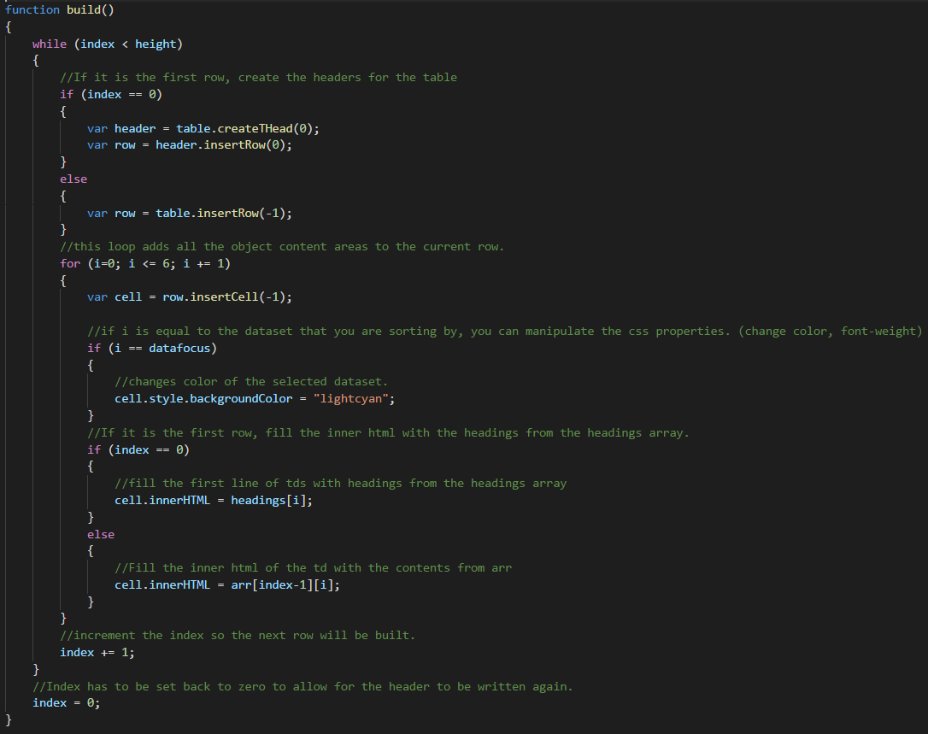
The Table in Phase 1
The table that we have in our team phase 1 version is not coded into the html page. It is procedurally generated from our build function. The while loop checks to see if our index variable is less than the number of items in our JSON file. If the while condition is true, a table row is generated. For the last generated row, 7 cells will be created (1 for name, height, length, speed, type, park, and continent). Once the cell is created, the correct value from our arr[] array is placed in the cell. These two loops happen until we have 508 rows with 7 cells each.

Slide 20
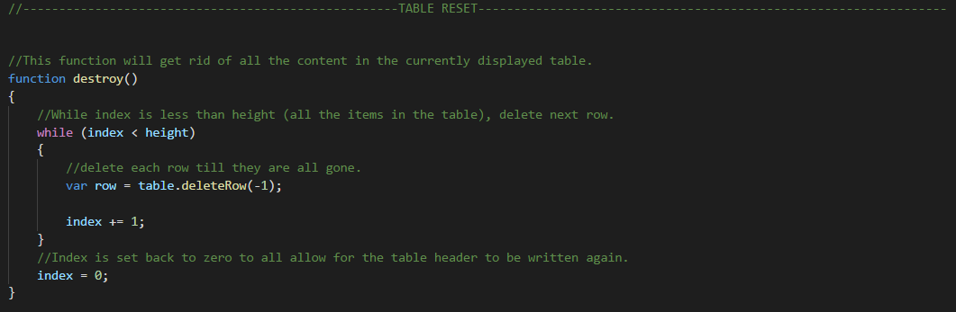
If you want to sort by a different value or get rid of the table, we opted to just destroy the entire thing and rebuild it from scratch if necessary. Trying to target individual cells and assign them different values seemed like it would be a lot of extra code, and destroying it seemed like it would be quicker and more efficient to us. The code below just loops 508 time and for every time deletes the corresponding row until the table is gone.

Slide 21
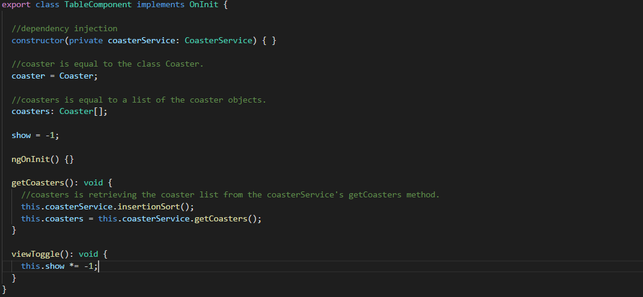
The Table in Angular
In Team Phase 2 we created a component to create and manipulate our table. Creating the table this time around was much easier because of some of Angular’s features.
Here is the list of our imports necessary for this component
In the constructor we declare a private instance of our CoasterService and then in the getCoasters function we call methods from that service and assign them to our coasters property.
We set up the table element and define the first row and first 6 cells in our template. From here, we create every other row and cell in the table with Angular’s ngFor directive. ngFor allows us to loop through all of the JSON objects in our database and create a row and 7 cells for each. We then bind the data from our CoasterService.getCoasters function to each cell using interpolation. Because all of the data presented in the table is bound to a specific row and cell, we didn’t need a destroy function this time around. If you sort by a different parameter, the correct value is automatically place in the right spot.
Here is out component controller’s code

Slide 22
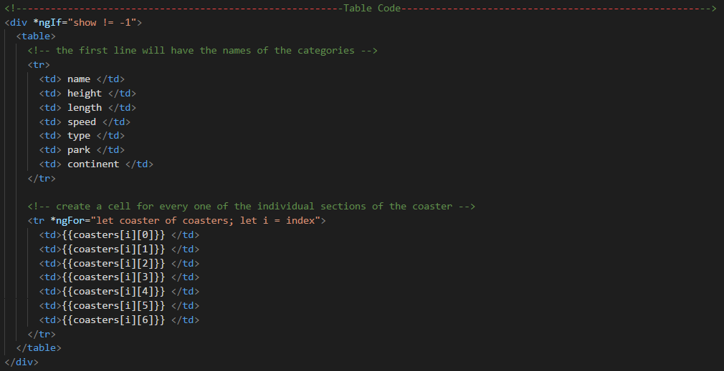
Our HTML template for the table component looks like this

Slide 23
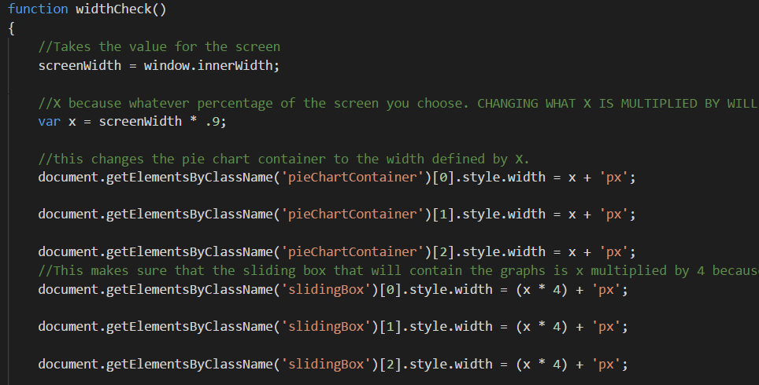
The Slider in Phase 1
In team phase 1 we created our sliders by creating a parent container and giving it the position absolute property and then placing a child container in it and giving it the position relative property. We then manipulate the position of the child container by adding or subtracting from the left property of the child in our slider.js file. If you add to the left value, the slider moves to the right. If you subtract from the left property, the slider move to the left. Were things got tricky was using 1 js file to manipulate 3 separate sliders. We had to use document.getElementByClassName a lot and things got confusing pretty quick. The widthCheck() function is sampled below:

Slide 24
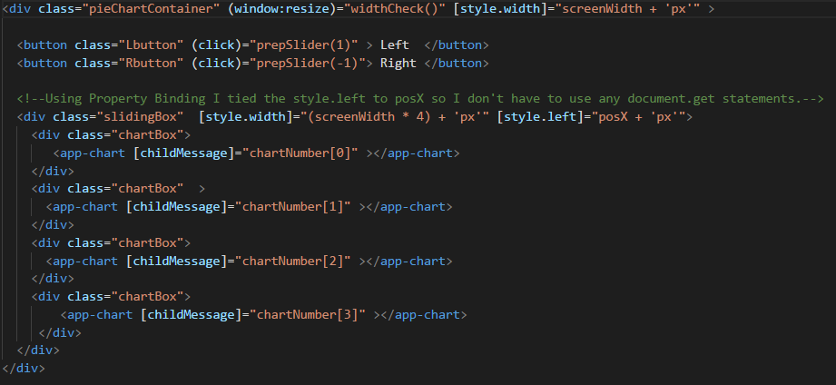
The Slider in Angular
We created a slider component in phase 2. Creating the sliders using components allowed us to make things less complicated because each slider operates independently, whereas all 3 sliders in team phase 1 were operated by one js file. If you wanted to add an additional slider to our team phase 1, you would have had to make a lot of adjustments in the slider.js script to account for an additional element added to the class. In phase two you could add or take away sliders and things would continue to function as normal because the code manipulating each one exists independently.
Here is the html template for our slider component

Slide 25
How Angular Made It Easy
property/attribute binding- In order to manipulate a specific element in vanilla js, you have use document.get. In Angular you can bind properties from components to elements which gets rid of the need to use document.get.
In the previous example we bound the style width css property to the variable screenwidth.
This made it so whenever the user resizes the window, the PieChartContainer class is resized to the appropriate width.
We also bound the style left css property to the posX variable. This allowed us to control which chart within our slider was displayed. In our team phase 2 we did not use any document.get functions. All instances of that approach were redone using property binding.
This component is the passing of information from the parent component to the child component. In the previous example the slider component is passing items from the chartNumber[] array to the child chart components. The chart component can then read this information and perform the appropriate task.

Slide 26
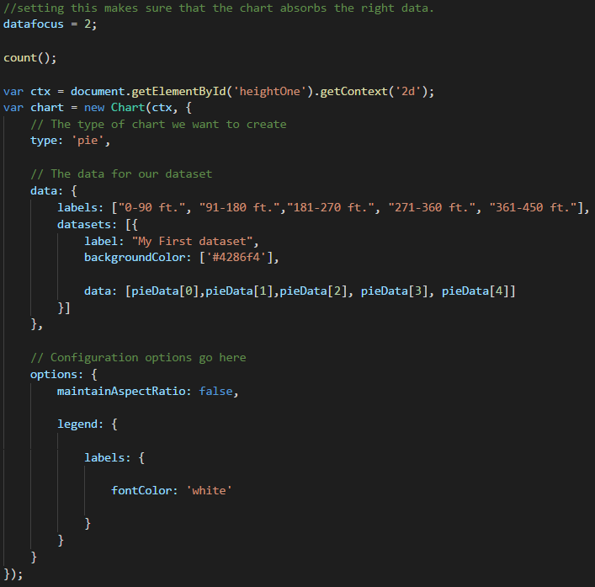
The Charts in Phase 1
In team phase 1 we created the charts by just reusing the same chart.js code over and over and over.
The code for building the chart looked like this:
Since we had so many charts we had this code copy and pasted about 12 times for all of our charts. The reason that we did this was because we needed a different ID for each canvas that we were drawing the chart on. This approach worked but was redundant at the same time because we had so much of the same code. It would have been nice to be able to re-use the same chart template for all of the charts.

Slide 27
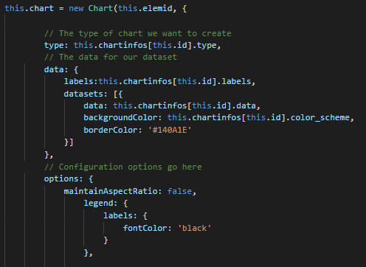
The Charts in Angular
In team phase 2 we created a chart component. This component allowed us to not have to re-use the same code over and over and over. The way that we approached this component was similar to the way that we approached the slider. Each chart is controlled independently rather than being controlled by 1 big js file.
This is the same basic charts js code template from team phase 1. The notable differences here are the assignment of new Chart at the top. Usually after new Chart you have to put an element id in the parentheses. In this case we are assigning the ids dynamically. This means that rather than hard coding the values we are retrieving them from the parent container. When we were passing the sliderComponent variable chartNumber[] to [childMessage] input, the chart component is reading that input and assigning it to this.elemid.
Here is some the controller code for our chart component

Slide 28
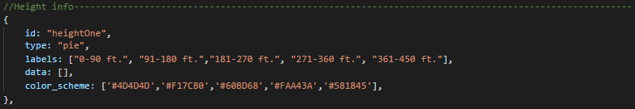
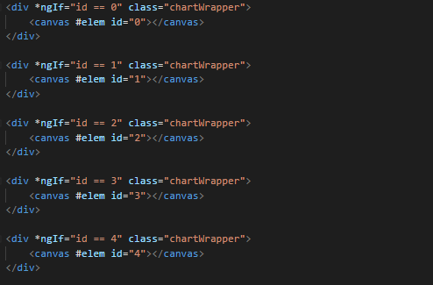
The info put into the chart template is supplied by our chart-info-list file. Our chart –info-list contains a list of chart-info objects. There is one chart-info object for each chart displayed in our application.
One are of difficulty with this component was getting the info to display the right way.Normally the components start with ngInit(){} but in this case we had to call ngAfterViewInit because the appropriate chart would load onto the canvas but it would not display the information provided. This was because the chart had not received the info before it loaded the view. Calling ngAfterViewInit allowed us to make sure that the component had all the info it needed before it loaded the view.
There is more instances of the ngIf directive here in the HTML template. The ngIf statements just make sure that the right chart is displayed.

Slide 29
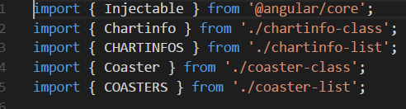
Coaster Services
Services are an object that supply data to your various components. Rather than coding all of your logic and data retrieval directly into your components themselves, you can create a service that does all of this for them. By creating a service, you can then call that service to supply all the components with their necessary information. This allows for a more streamlined design because the components themselves are only controlling what is displayed on the screen rather than the data manipulation. If you had to get rid of a component, you would not need to find a new place to put your logic but with the service, you don’t have to worry about that. The service we created is the file that contains all of our sorting and data manipulation. The only thing that a component needs to access this information is to import the service and then call, this.coasterService.method name.

Slide 30
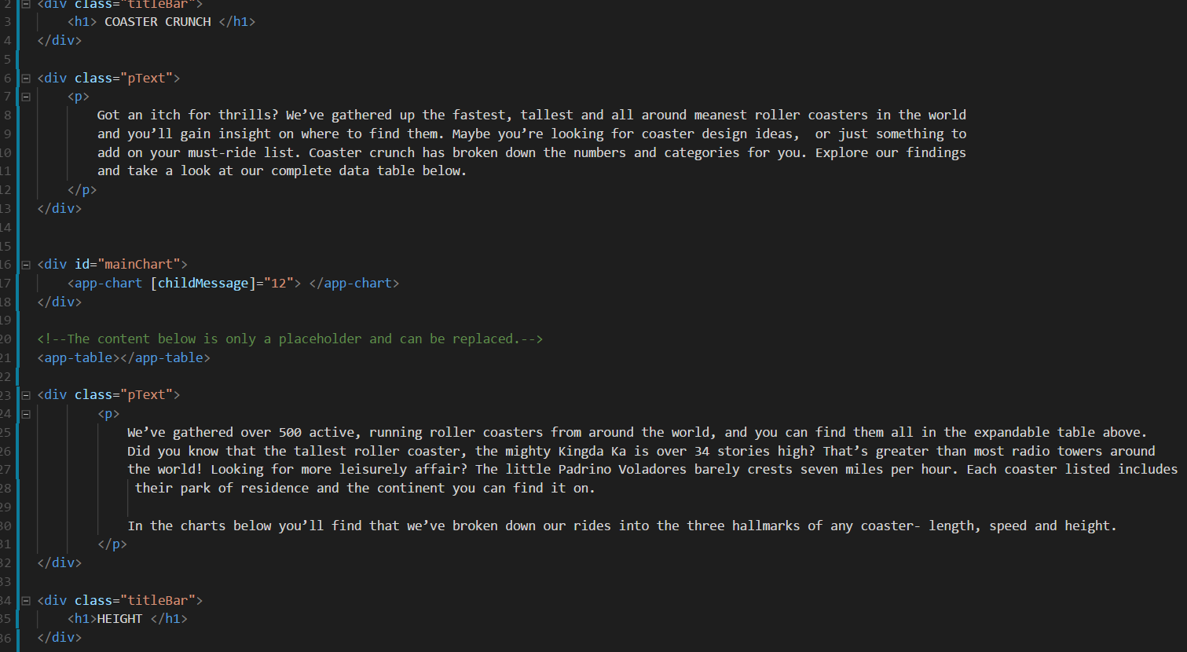
Pulling It All Together
With all of the pieces ready, we brought it together into our app.component.hml. In this case, we built the paragraph text directly into the app template for the sake of time. Just like everything else you’ve seen today about components however, this could have been easily made its own. The sample below demonstrates the components coming together. We then used much of the same CSS from team phase 1 for styling. And that’s it! That is how Coaster Crunch came together!

Slide 31
Check out the Coaster Crunch Github!
https://github.com/ibalukt/team-phase-2

